Slide 1
Notes:
asdf

Slide 2
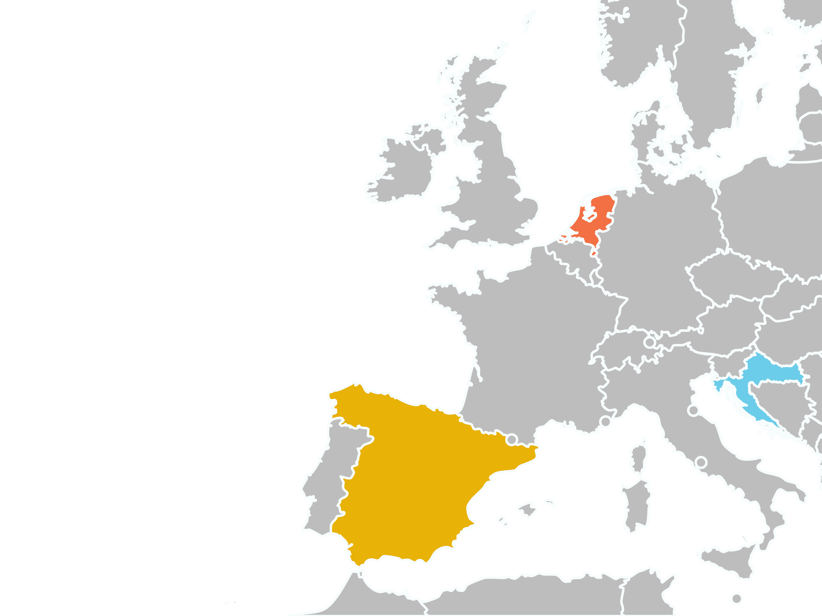







VALENCIA
ROTTERDAM
ROTTERDAM
BARCELONA
(non-pilot site)
RIJEKA
RIJEKA
BARCELONA
VALENCIA

Slide 3

Objectives
To analyse the impact of the urban built environment on the prevalence and incidence of NCDs (specifically, T2DM and CVDs) and associated risk behaviours.
To implement behavioural change interventions focused on empowering citizens, especially vulnerable populations, to approach their relationship with the urban environment by reducing NCD risk behaviours.
To provide evidence on the effectiveness of behavioural change interventions and interventions modifying the urban built environment on health outcomes and risk behaviours.

Slide 4
WP2 – Identifying and measuring the association between urban environment features an NCDs
Two lines of observational analysis:
Comparison of odds of risk behaviours between neighbourhood types (Valencia, Rotterdam, Rijeka):
  Risk behaviours: sedentary lifestyle, poor dietary habits, alcoholism, smoking, sleep deprivation, etc.
  Neighbourhood types: classification based on implementing clustering methods on neighbourhood-level indicators (physical-functional characteristics of urban environment).
  Adjusted by individual and area-level covariates.
Comparison of incidence between "treated" vs. "untreated" areas (Valencia, Rijeka):
  Quasi-experimental design.
  Well-defined staggered interventions (large urban parks and cycle lanes with different buffer areas).
  Propensity Score Weighting.
  Data from health records.

Slide 5
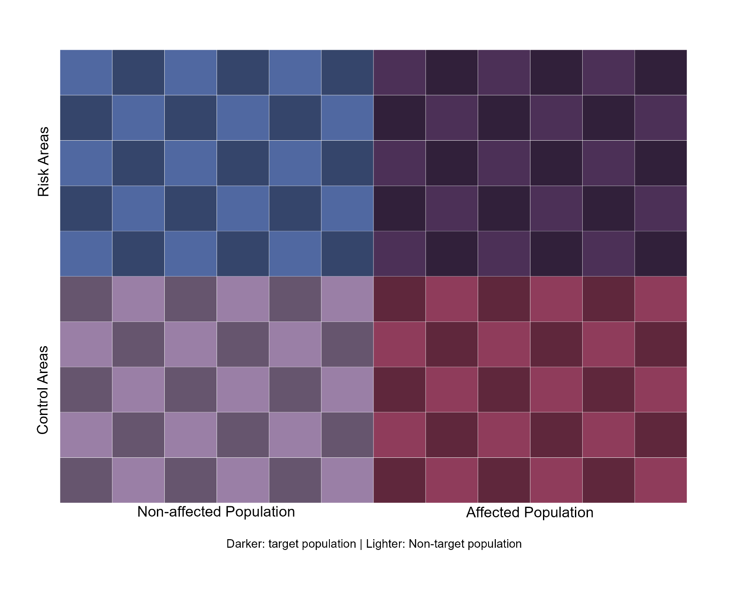
WP3 – Exploring behavioural causal links
Mixed-methods analysis:
GIS-supported Focus Groups:
  6 FGs per city.
  8 to 10 participants each.
  Profile heterogeneity between.
  Citizen Science approach.
GIS-supported In-depth Interviews:
  30 per city.
  Participants from key areas.
  Habits and routines.

Slide 6


WP4 – Pilots
Pilot Preparation:
Design and framework development for pilot studies in the three cities Implementation of a cognitive-behavioral intervention supported by a digital solution (Wakamola app)
Customization based on urban characteristics and socio-health needs.
Pilot Studies:
9-month longitudinal trial.
Sample of 300 participants per site (ntreatment group = 150 vs. ncontrol group = 150).
Deployment of a social network for digital communication and support.

Slide 7
WP5 – Evaluation
Evaluation Framework:
Plan for pre-post evaluation.
Recruitment and baseline data collection.
Effectiveness of Interventions:
Assess impact on lifestyle behavior outcomes.
Statistical analysis through mixed-effect models.
Implementation Evaluation:
Focus groups with stakeholders and citizens to define Program Theory.
Assess intervention acceptability, feasibility, sustainability and other dimensions.
Social Network Analysis:
Analyze interactions via Wakamola network.
Study influence on quality of life using network graphs.

Slide 8
WP6 – Communication, Dissemination & Policy Recommendations
HORUS Platform:
Develop an interactive visual content platform.
Support GIS-based research and policy recommendations.
Policy Recommendations:
Conduct context analysis across multiple dimensions.
Collaborative preparation with local stakeholders.
Validate recommendations using a scoring system.

